Slide 1
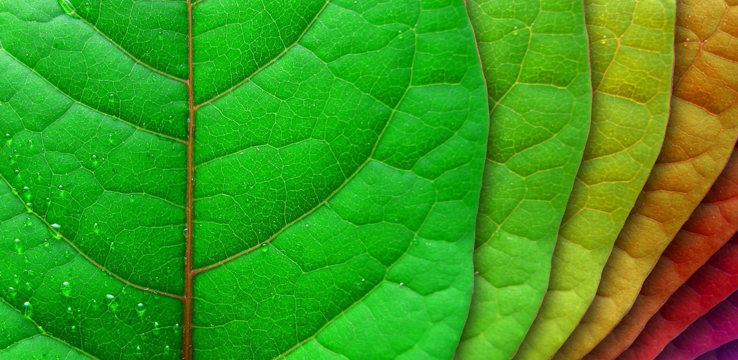
KLASIFIKASI CITRA DAUN
Oleh :
Desta Sandya P

Slide 2

Latar Belakang
Sekitar 350.000 spesies tanaman yang ada di bumi. Tanaman memainkan peran utama dalam berbagai bidang, seperti makanan, ilmu kedokteran, industri, dan lingkungan.
Penting untuk peneliti menginventaris tumbuhan-tumbuhan yang ada

Slide 3
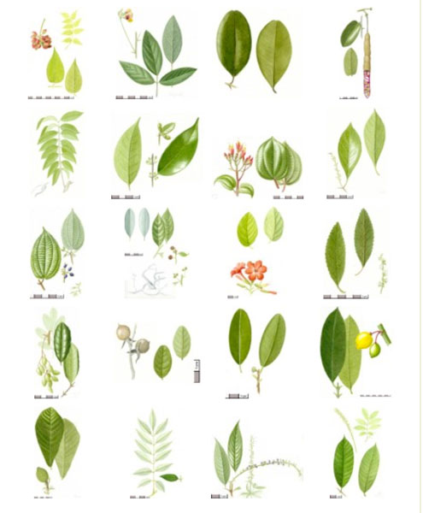

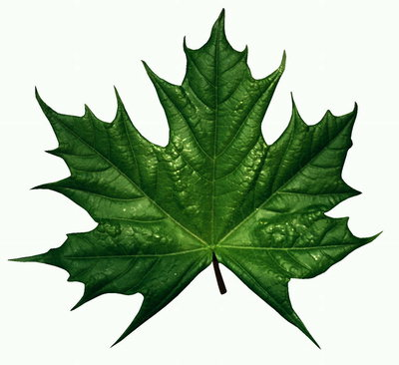

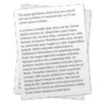
Latar Belakang
Dibandingkan
Herbarium
Peneliti
Text Book / Dokumen

Slide 4
Latar Belakang
Bisa Rusak
Dibandingkan
Herbarium
Peneliti
Tidak Efisien
Lama dan Merepotkan
Text Book / Dokumen

Slide 5


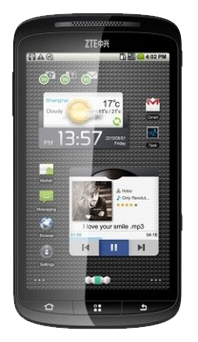

Latar Belakang
Hasil Identifikasi
Citra

Slide 6
Paper yang Dibahas
Wu, S.G. 2007. “A Leaf Recognition Algorithm for Plant Classification Using Probabilistic Neural Network”. The 7th IEEE International Symposium on Signal Processing and Information Technology (2007).
Lee, Kue-Bum., and Kwang-Seok Hong. “An Implementation of Leaf Recognition System using Leaf Vein and Shape”. International Journal of Bio-Science and Bio-Technology 5. 2 2013: 57-66.
Herdiyeni, Yeni et al. “A Computer Aided System for Tropical Leaf Medicinal Plant Identification”. International Journal Advanced Science Engineering Information Technology 3.1 2013: 23-27.

Slide 7
Paper 1: A Leaf Recognition Algorithm for Plant Classification Using Probabilistic Neural Network
Pra-proses
Ekstraksi Ciri
PCA
Train PNN
Test PNN

Slide 8
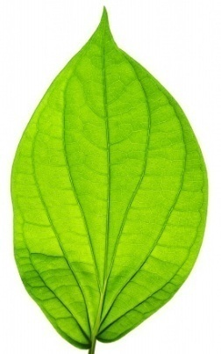
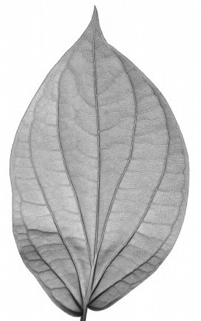
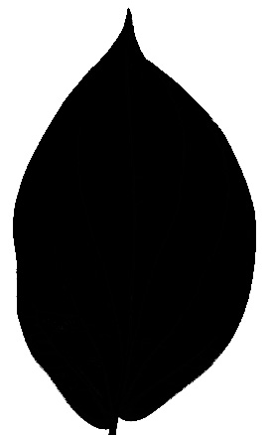
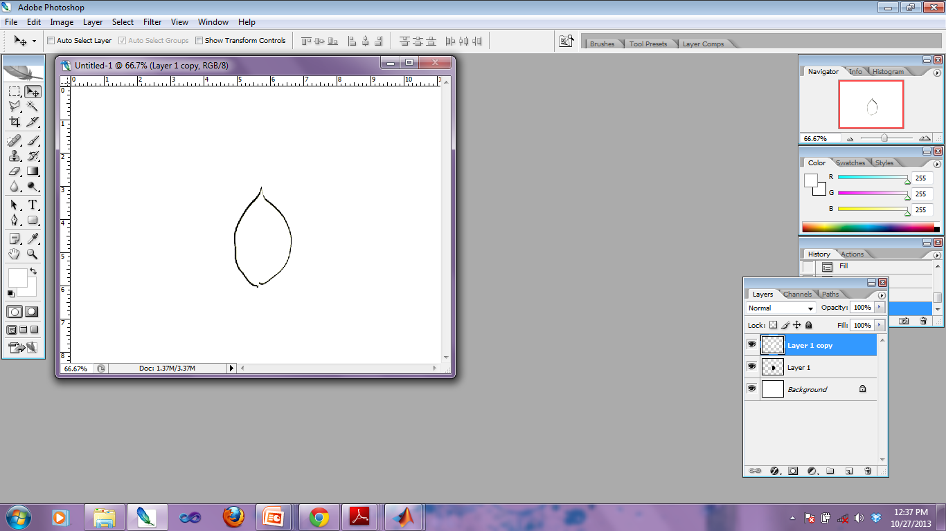
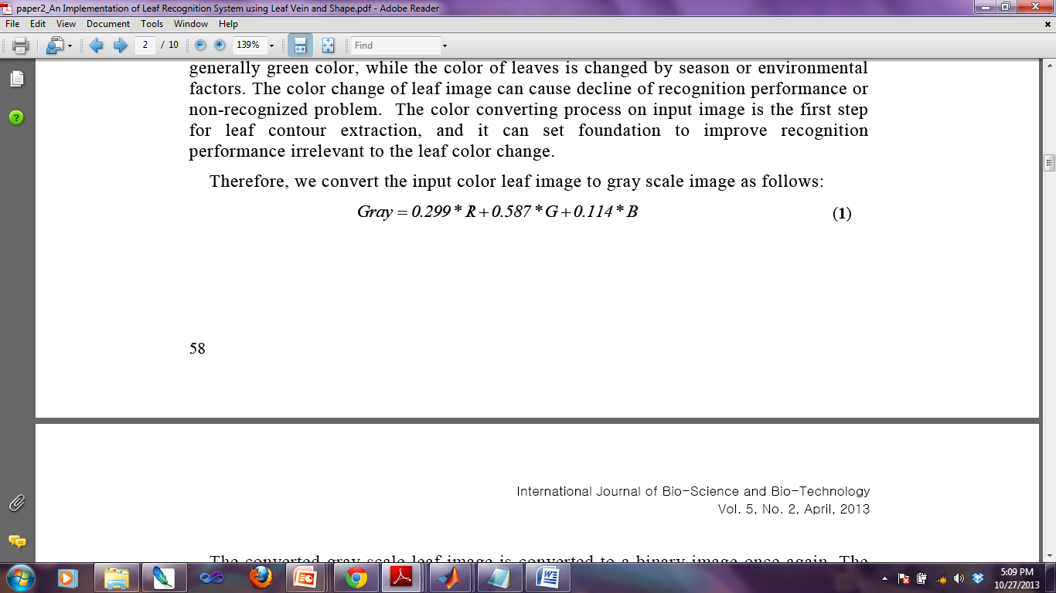
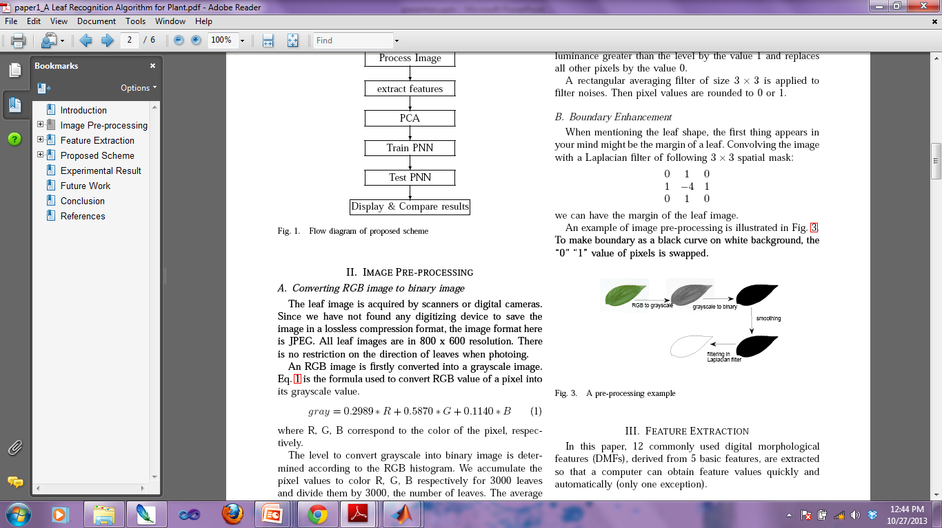
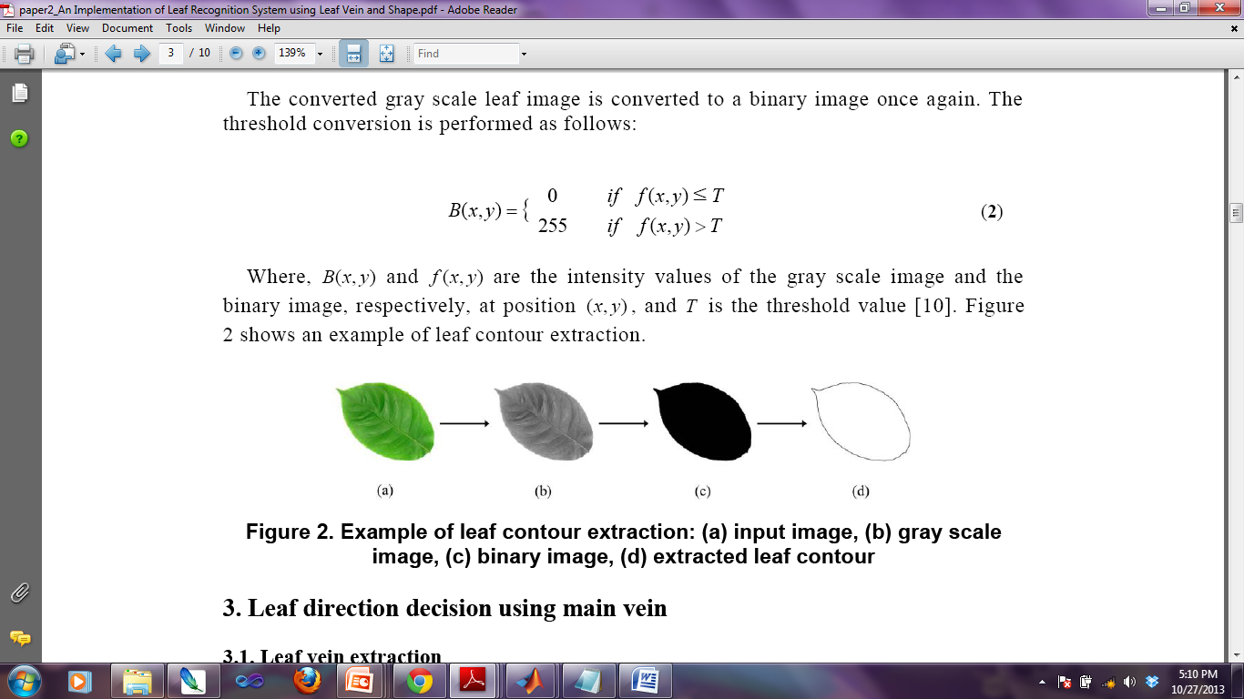
Pra-Proses
Hasil filtering dengan Laplacian filter
RGB
Gray Scale
Binary Image
Hasil smoothing
smoothing
filtering
Laplacian filter (3 * 3)

Slide 9
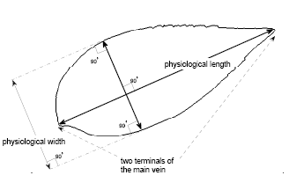
Ekstraksi Ciri (12 Ciri)
5 Ciri Geometrik Dasar
Diameter
Panjang Fisik
Lebar Fisik
area
perimeter atau keliling daun
12 Ciri Morfologi Digital
smooth factor
Aspect ratio
form factor
Rectangularity
Narrow factor
Perimeter ratio of diameter
Perimeter ratio of physiological length and physiological Width
5 Vein features

Slide 10
12 Ciri Morfologi Digital
Smooth Factor
Rasio antara area citra helai daun yang dihaluskan dengan 5x5 rectangular averaging filter dan area citra helai daun yang dihaluskan dengan 2x2 rectangular averaging filter.
Aspect ratio
Lp/Wp
Form factor
4πA/P²
Rectangularity
Lp.Wp/A
Narrow factor
D/Lp
Rasio antara perimeter dan diameter (P/D)
Ratio antara perimeter dan Lp+Wp
P/(Lp +Wp)
5 Vein features

Slide 11
5 Vein features
5 ciri urat daun:
V1= Av₁ / A
V2= Av₂ / A
V3= Av₃ / A
V4= Av₄ / A
V5= Av₄ / Av₁
A= luas daun asli
Av₁= citra daun asli dikurangi citra daun dikonvolusi dengan filter radius 1
Av₂= citra daun asli dikurangi citra daun dikonvolusi dengan filter radius 2
Av₃= citra daun asli dikurangi citra daun dikonvolusi dengan filter radius 3
Av₄= citra daun asli dikurangi citra daun dikonvolusi dengan filter radius 4

Slide 12
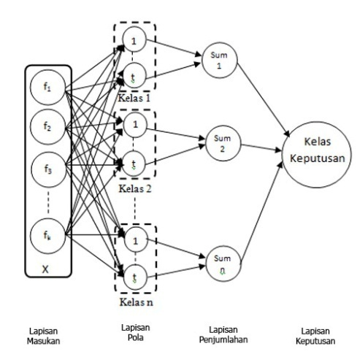
Probabilistic Neural Network (PNN)
12 Ciri Morfologi Digital
Principal Component Analysis (PCA)
Probabilistic Neural Network (PNN)

Slide 13
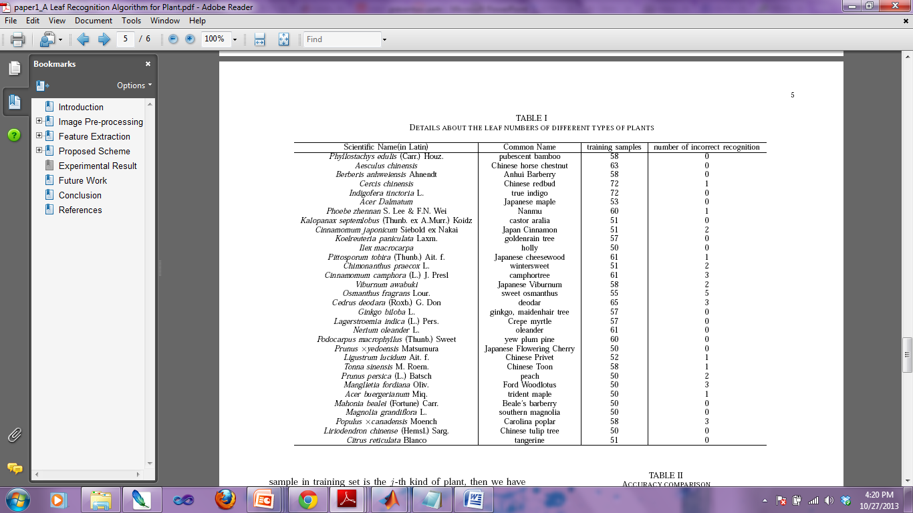
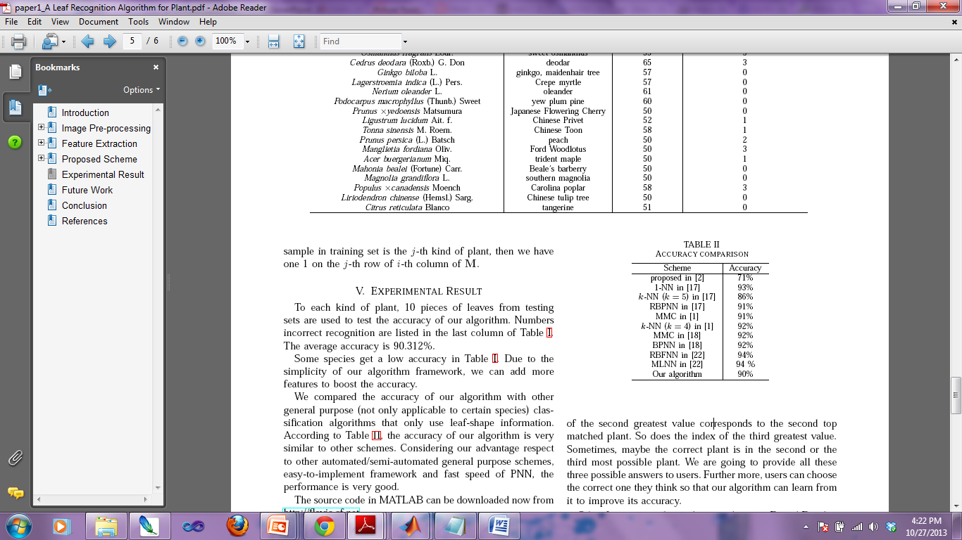
Akurasi
90.312%
Perbandingan Akurasi dengan
Penelitian-penelitian yang Lain

Slide 14
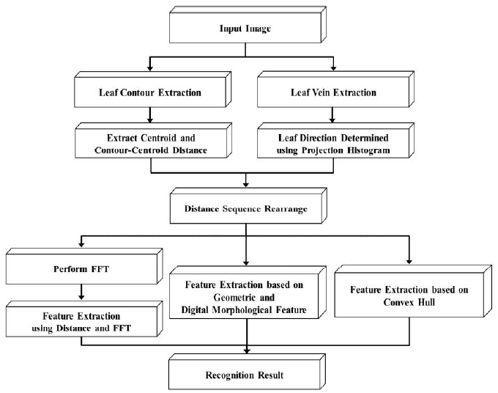
Paper 2: An Implementation of Leaf Recognition System using Leaf Vein and Shape

Slide 15
Leaf Contour Extraction
RGB
Gray Scale
Binary Image
extracted leaf contour

Slide 16
Leaf feature extraction
Distance and FFT-based frequency
domain analysis
10 Feature
Geometric and digital
morphological features
10 Feature
21 Feature
Convex hull
1 Feature

Slide 17
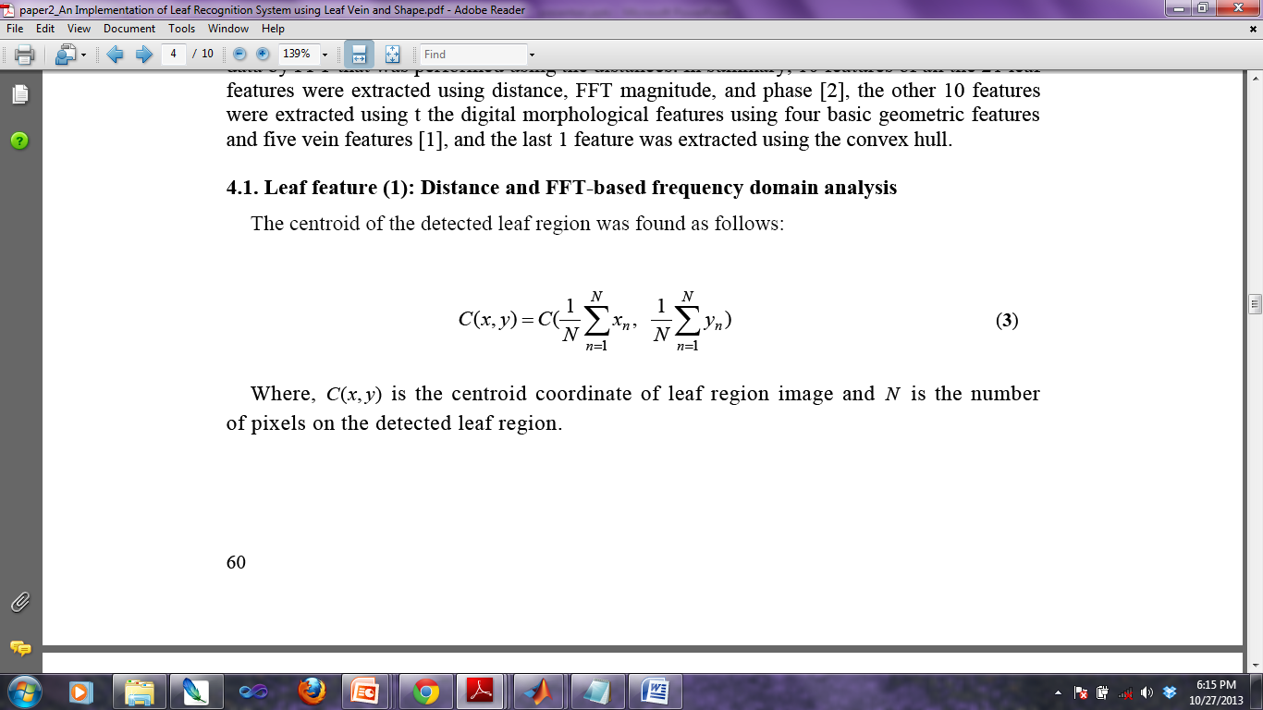
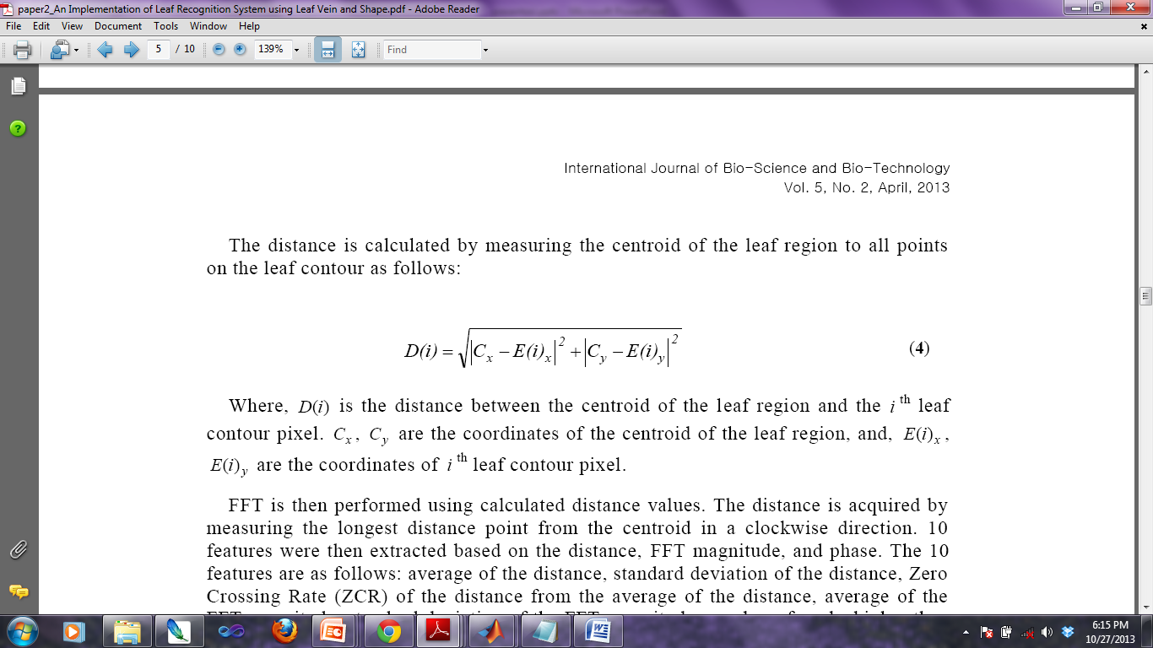
Distance and FFT-based frequency domain analysis
Citra Biner
Citra Kontur

Slide 18
Distance and FFT-based frequency domain analysis (10 Feature)
Dari Jarak antara piksel centroid dengan kontur D(i),
diturunkan 10 ciri sebagai berikut:
Average of the distance
Standard deviation of the distance
Zero Crossing Rate (ZCR) of the distance from the average of the distance
Average of the FFT magnitude
Standard deviation of the FFT magnitude
Number of peaks higher than the average of the FFT magnitude
The priority of the top ten peaks of the FFT magnitude
Average of the FFT phase
Standard deviation of the FFT phase
ZCR of the FFT phase from the average of the FFT phase.

Slide 19
Geometric and digital morphological features (10 Feature)
4 geometric features
leaf length, leaf width, leaf area, leaf perimeter
10 digital morphological features
aspect ratio
form factor
rectangularity
rasio perimeter dan panjang
rasio perimeter dan panjang + lebar daun
5 ciri urat daun

Slide 20
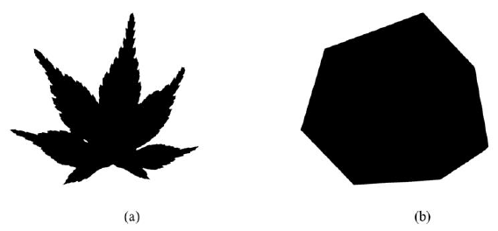
Convex hull
Dalam Paper ini convex hull digunakan untuk mencerminkan kompleksitas kontur daun.
input image
convex hull image.

Slide 21
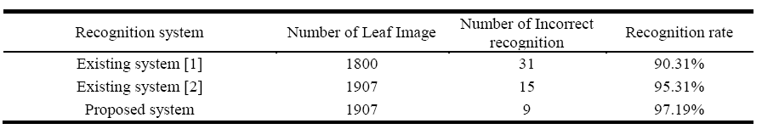
Experimental result for proposed leaf recognition system

Slide 22
Paper 3: A Computer Aided System for Tropical Leaf Medicinal Plant Identification
Feature Extraction:
Morphological Feature Extraction
Diameter, area, perimeter, smooth factor, form factor, ratio perimeter and diameter, also five features of leaf vein
Texture Feature Extraction
LBPV(8,1)
Shape Feature Extraction
Fourier descriptors
Klasifikasi:
30 kelas, masing-masing kelas ada 48 citra
80 % Training and 20 % Testing
PNN
Feature Combination:
Product Decision Rule (PDR)

Slide 23
Local Binary Patterns Variance (LBPV)
LBPriu
Tidak sensitif (invariant) terhadap perubahan rotasi
VAR
bersifat uniform
Mengukur lokal kontras tekstur
LBPV

Slide 24
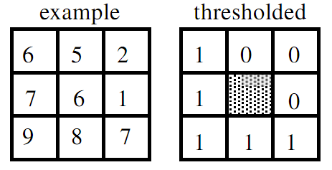
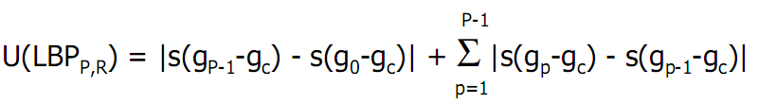
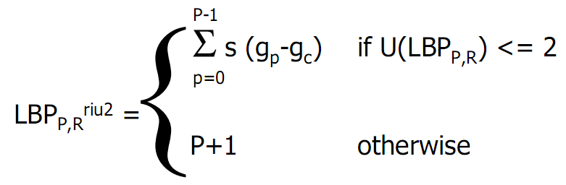
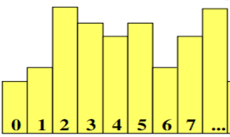
Ekstraksi dengan Riu
Perhitungan uniform patterns
= 0 + (1+0+0+1+0+0+0)
= 2
Pola: 11110001
Perhitungan uniform patterns
Menghitung banyaknya bit 1 pada pola LBP
Maka nilai Riu=5
P+1

Slide 25
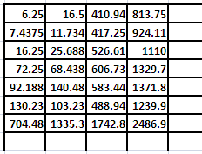
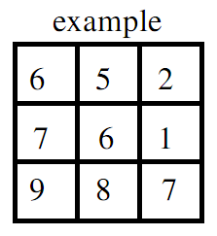
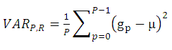
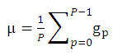
Ekstraksi dengan Var
Var mengukur lokal kontras tekstur pada suatu citra.
dengan
Var_{P,R} = 1/8 (55.878)
= 6.985
= 1/8 (6+5+2+1+7+8+9+7)
= 5.625

Slide 26
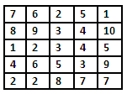
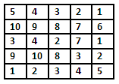
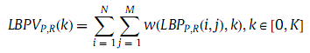
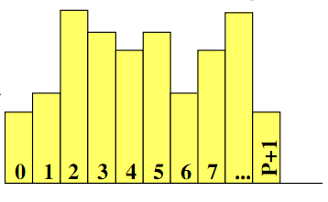
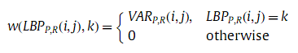
Ekstraksi dengan LBPV
Riu
Var
Riu
LBPV
Var
H(0) = 0
H(1) = 1+3=4
H(2) = 3+4+1+2=10
H(3) = 8+2+3=13
…….dst.
Penjumlahan nilai-nilai Var pada nilai LBPriu2 tertentu di posisi yang sama

Slide 27
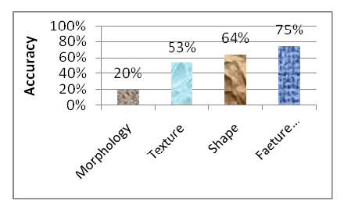
Accuracy

Slide 28
Penelitian yang Diusulkan: Klasifikasi Citra Daun Menggunakan Fitur Morfologi, Bentuk dan Tekstur dengan Probabilistic Neural Network
Menggabungkan 3 fitur
Fitur 1 = Morfologi
Fitur 2 = Convex Hulls
Fitur 3 = LBPriu (Tekstur)
Menggunakan Klasifier PNN (Training 80 %, Testing 20%).
Menggunakan data by Stephen Gang Wu (http://flavia.sourceforge.net/) → 32 kelas citra daun

Slide 29
Reference
Wu, S.G. 2007. “A Leaf Recognition Algorithm for PlantClassification Using Probabilistic Neural Network”. The 7th IEEE International Symposium on Signal Processing and Information Technology (2007).
Lee, Kue-Bum., and Kwang-Seok Hong. “An Implementation of Leaf Recognition System using Leaf Vein and Shape”. International Journal of Bio-Science and Bio-Technology 5. 2 2013: 57-66.
Herdiyeni, Yeni et al. “A Computer Aided System for Tropical Leaf Medicinal Plant Identification”. International Journal Advanced Science Engineering Information Technology 3.1 2013: 23-27.
Guo, Z.,Lei Zhang, David Zhang. “Rotation Invariant Texture Classification using LBP Variance (LBPV) with global matching”. Pattern Recognition 43(2010): 706–719.
Mäenpää, Topi. “The Local Binary Pattern Approach To Texture Analysis – Extensions And Applications”. Infotech Oulu and Department of Electrical and Information Engineering, University of Oulu. 2003.
Ojala, T et al. “Multiresolution Gray-Scale and Rotation Invariant Texture Classification with Local Binary Patterns”. Ieee Transactions On Pattern Analysis And Machine Intelligence 24.7 2002: 971-986.

Slide 30


TERIMA KASIH
Semoga Bermanfaat

